Slide 1
Hypothesis Testing
Chapter 10

Slide 2
10.4 – Tests for a Single Mean
We have now covered the main ideas of hypothesis testing. In 10.4 and 10.5, we apply those ideas to tests regarding means. The examples we saw at the end of 10.3 cover the first case we are interested in for 10.4.
There are two main cases we consider in 10.4:
  Hypothesis test for a single mean when the population variance is known (z-test)
  Hypothesis test for a single mean when the population variance is unknown (t-test)

Slide 3
10.4 – Tests for a Single Mean
We have essentially covered everything we need for the first case. One thing to remember is that, by the central limit theorem, we can do a z-test for any population that has a mean and finite variance. When we look at t-tests later, we need the population to be normal or approximately normal.
We will not say anything else about using a p-value in this case, but we will look just a little bit more into using a critical value to make the decision.

Slide 4

10.4 – Tests for a Single Mean
When we think of the critical region, we usually think of it in terms of the standard normal distribution. This is what we did in the last example of 10.3, where we transformed $\overline{x}$ into a z-value in order to compare it to the critical values we found.

Slide 5
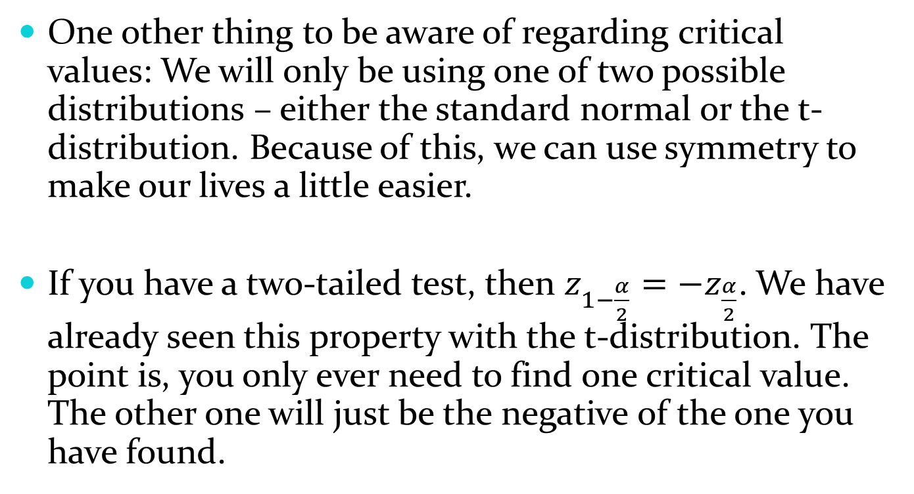
10.4 – Tests for a Single Mean
One other thing to be aware of regarding critical values: We will only be using one of two possible distributions – either the standard normal or the t-distribution. Because of this, we can use symmetry to make our lives a little easier.
If you have a two-tailed test, then $z_{1−\frac{α}{2}}=−z_{\frac{α}{2}}$. We have already seen this property with the t-distribution. The point is, you only ever need to find one critical value. The other one will just be the negative of the one you have found.

Slide 6
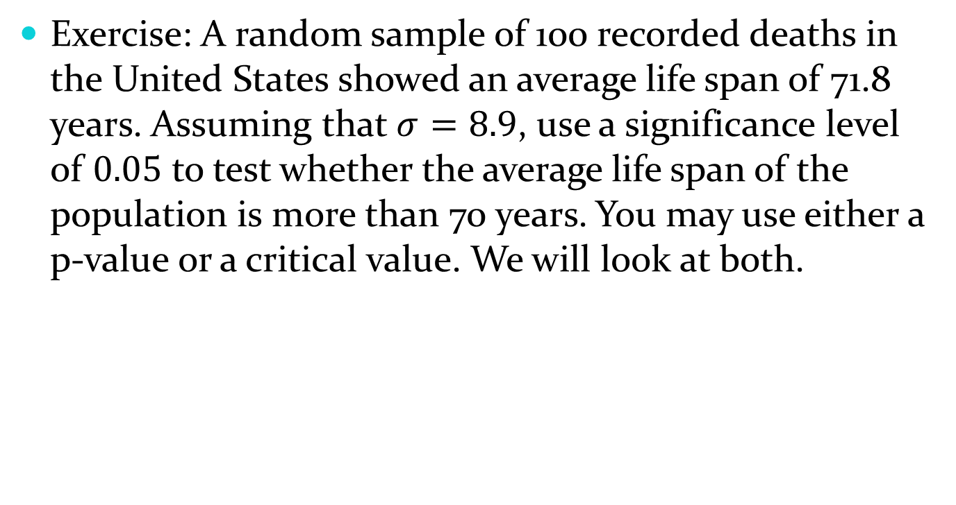
10.4 – Tests for a Single Mean
Exercise: A random sample of 100 recorded deaths in the United States showed an average life span of 71.8 years. Assuming that $σ=8.9$, use a significance level of $0.05$ to test whether the average life span of the population is more than 70 years. You may use either a p-value or a critical value. We will look at both.

Slide 7
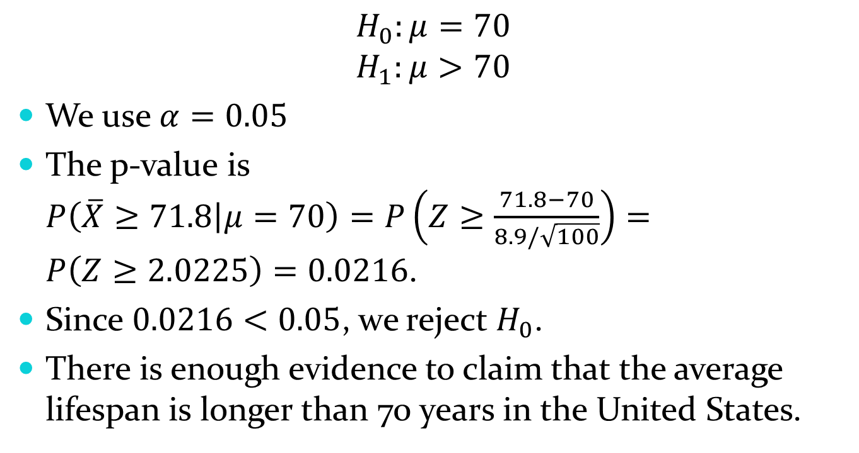
10.4 – Tests for a Single Mean
$$H_{0}:μ=70$$
$$H_{1}:μ>70$$
We use $α=0.05$
The p-value is $P\left(\overline{X}≥71.8 | μ=70\right)=P\left(Z≥\frac{71.8−70}{8.9/\sqrt{100}}\right)=P\left(Z≥2.0225\right)=0.0216$.
Since $0.0216<0.05$, we reject $H_{0}$.
There is enough evidence to claim that the average lifespan is longer than 70 years in the United States.

Slide 8
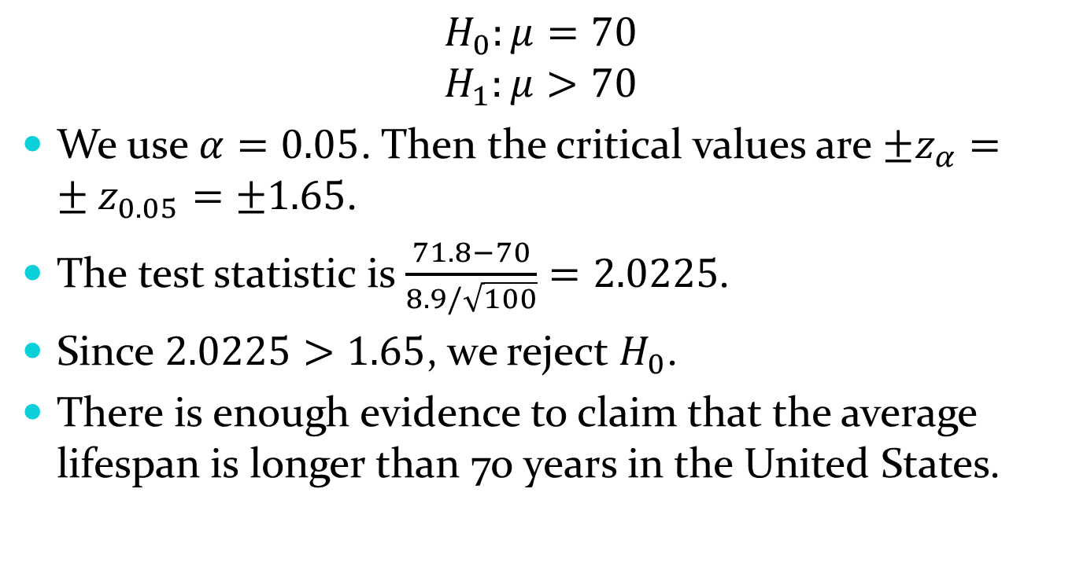
10.4 – Tests for a Single Mean
$$H_{0}:μ=70$$
$$H_{1}:μ>70$$
We use $α=0.05$. Then the critical values are $±z_{α}=±z_{0.05}=±1.65$.
The test statistic is $\frac{71.8−70}{8.9/\sqrt{100}}=2.0225$.
Since $2.0225>1.65$, we reject $H_{0}$.
There is enough evidence to claim that the average lifespan is longer than 70 years in the United States.

Slide 9
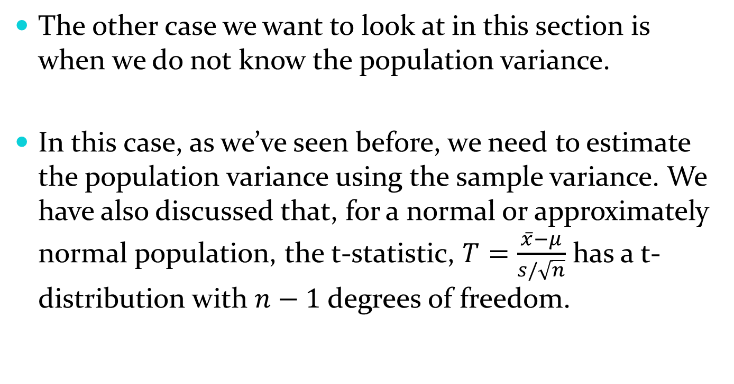
10.4 – Tests for a Single Mean
The other case we want to look at in this section is when we do not know the population variance.
In this case, as we’ve seen before, we need to estimate the population variance using the sample variance. We have also discussed that, for a normal or approximately normal population, the t-statistic, $T=\frac{\overline{x}−μ}{s/\sqrt{n}}$ has a t-distribution with $n−1$ degrees of freedom.

Slide 10
10.4 – Tests for a Single Mean
Other than the fact that we are using a different sampling distribution, t-tests look a lot like z-tests. We can proceed almost exactly as we did for z-tests.

Slide 11
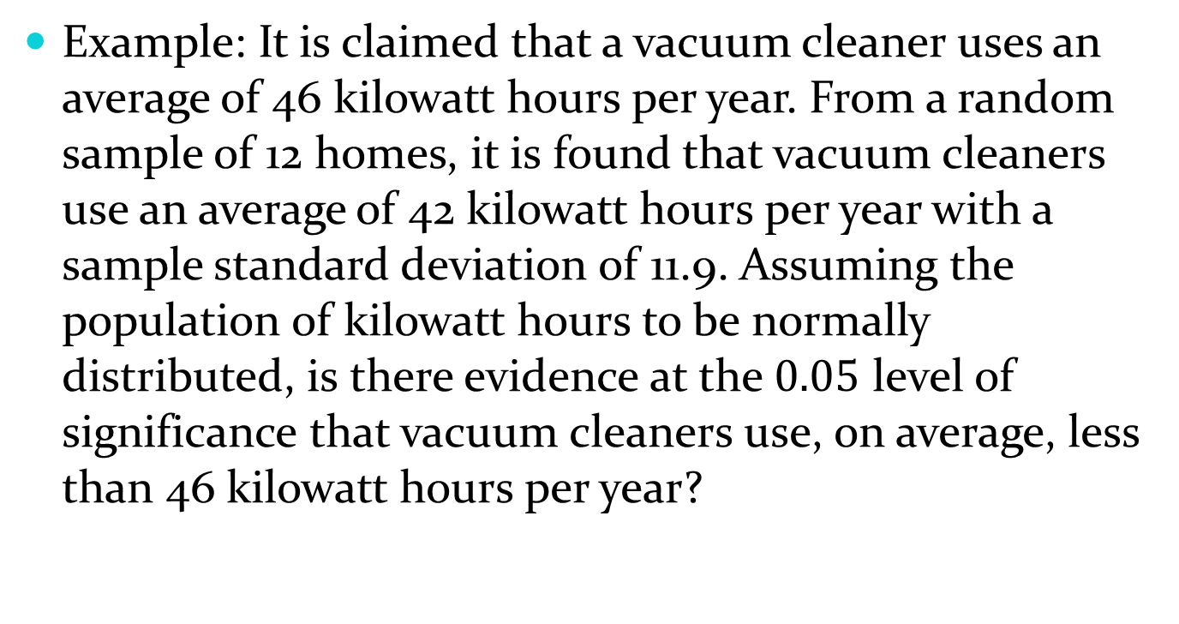
10.4 – Tests for a Single Mean
Example: It is claimed that a vacuum cleaner uses an average of 46 kilowatt hours per year. From a random sample of 12 homes, it is found that vacuum cleaners use an average of 42 kilowatt hours per year with a sample standard deviation of 11.9. Assuming the population of kilowatt hours to be normally distributed, is there evidence at the $0.05$ level of significance that vacuum cleaners use, on average, less than 46 kilowatt hours per year?

Slide 12
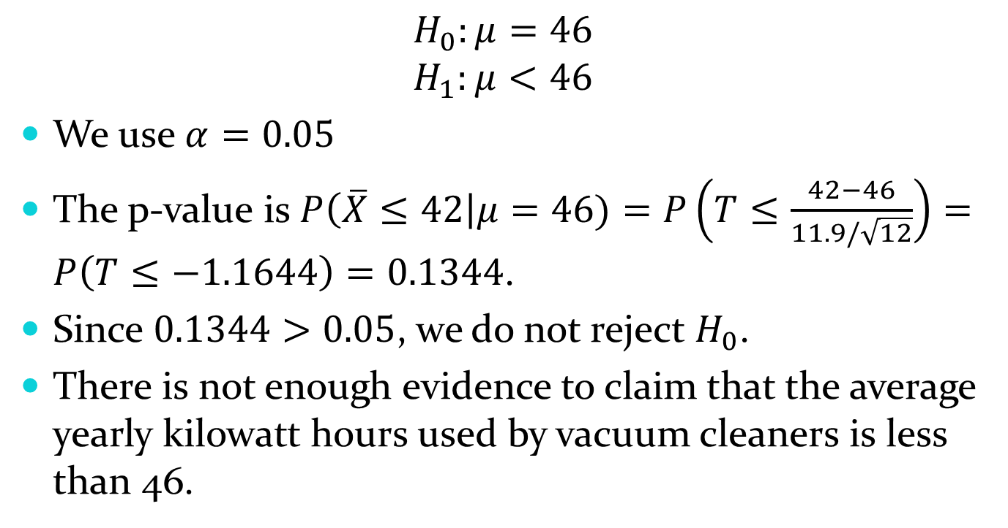
10.4 – Tests for a Single Mean
$$H_{0}:μ=46$$
$$H_{1}:μ<46$$
We use$α=0.05$
The p-value is $P\left(\overline{X}≤42\right|μ=46)=P\left(T≤\frac{42−46}{11.9/\sqrt{12}}\right)=P\left(T≤−1.1644\right)=0.1344$.
Since $0.1344>0.05$, we do not reject $H_{0}$.
There is not enough evidence to claim that the average yearly kilowatt hours used by vacuum cleaners is less than 46.

Slide 13
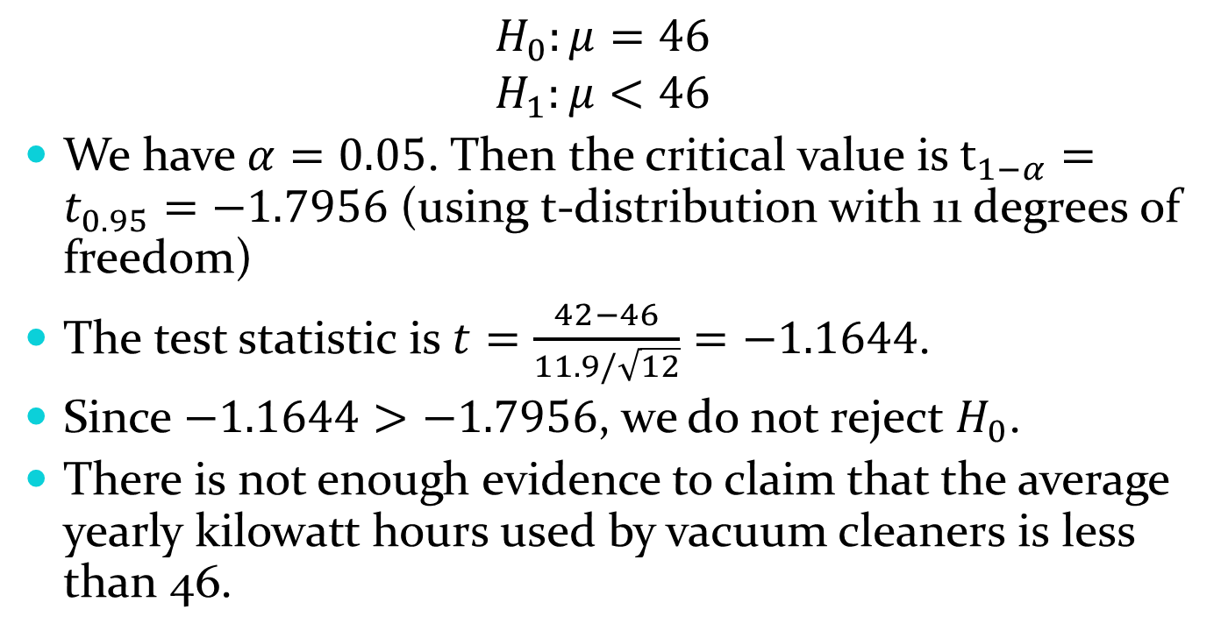
10.4 – Tests for a Single Mean
$$H_{0}:μ=46$$
$$H_{1}:μ<46$$
We have $α=0.05$. Then the critical value is $t_{1−α}=t_{0.95}=−1.7956$ (using t-distribution with 11 degrees of freedom)
The test statistic is $t=\frac{42−46}{11.9/\sqrt{12}}=−1.1644$.
Since $−1.1644>−1.7956$, we do not reject $H_{0}$.
There is not enough evidence to claim that the average yearly kilowatt hours used by vacuum cleaners is less than 46.

Slide 14
10.4 – Tests for a Single Mean
What kind of error could we have made in the previous example?
Explain that error in the context of the problem.

Slide 15
10.4 – Tests for a Single Mean
Since we failed to reject the null hypothesis, we could have made a type II error.
This would mean that we failed to conclude that the average number of kilowatt hours used by vacuum cleaners in a year is less than 46 when it actually is.

Slide 16
10.5 – Test for Two Means
In this section, we consider hypothesis tests for the difference of two means. Recall that we gave the distribution for the difference of two means (when the population variances are known) in section 8.4. We will use this distribution as well as two others to conduct hypothesis tests that will allow us to compare two means.

Slide 17
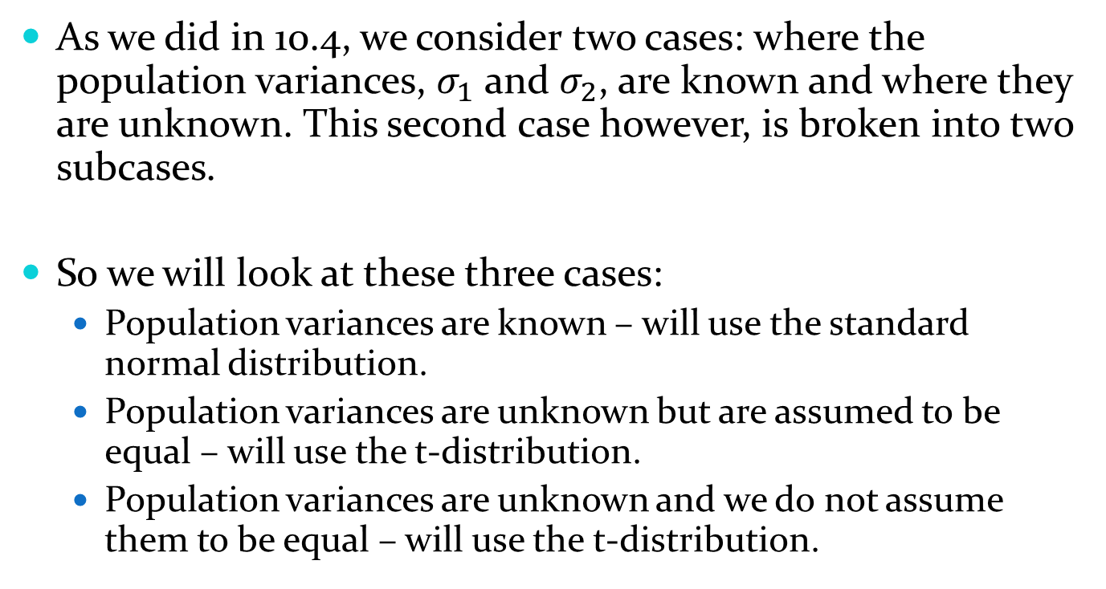
10.5 – Test for Two Means
As we did in 10.4, we consider two cases: where the population variances, $σ_{1}$ and $σ_{2}$, are known and where they are unknown. This second case however, is broken into two subcases.
So we will look at these three cases:
  Population variances are known – will use the standard normal distribution.
  Population variances are unknown but are assumed to be equal – will use the t-distribution.
  Population variances are unknown and we do not assume them to be equal – will use the t-distribution.

Slide 18
10.5 – Test for Two Means
The reason we have to break up the unknown variance case into two subcases is that the t-distribution we use is different depending on whether or not we assume the variances to be equal (that is, they have different degrees of freedom).
Once we know the distribution we are using, everything else proceeds in exactly the same way as we have seen so far.

Slide 19

10.5 – Test for Two Means
Case 1: Known population variances. If we know $σ_{1}$ and $σ_{2}$, then our test statistic follows the standard normal distribution. That is, we can use $Z=\frac{{\overline{X}}_{1}−{\overline{X}}_{2}−\left(μ_{1}−μ_{2}\right)}{\sqrt{\frac{σ_{1}^{2}}{n_{1}}+\frac{σ_{2}^{2}}{n_{2}}}}$ as the test statistic. Then critical values or p-values can be found using the standard normal distribution.

Slide 20
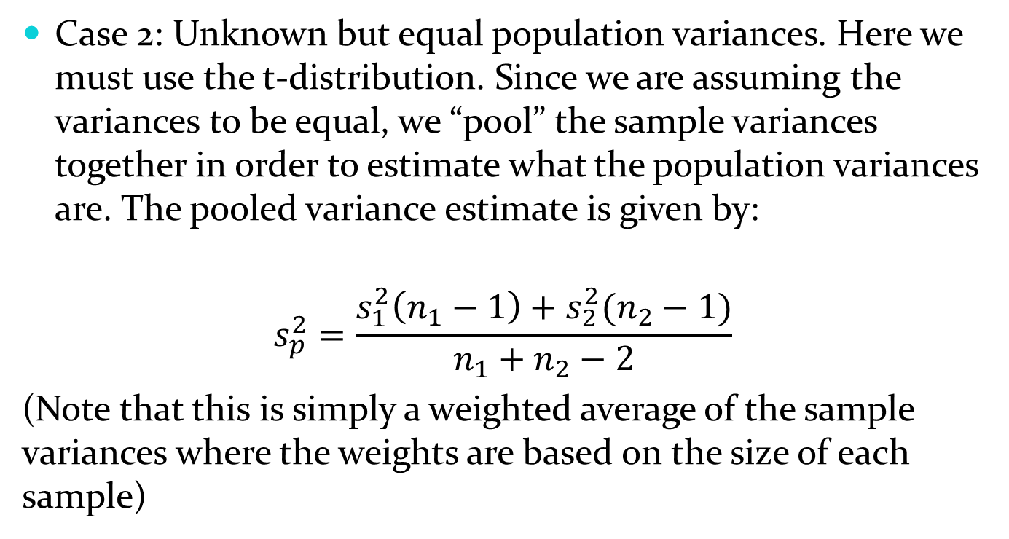
10.5 – Test for Two Means
Case 2: Unknown but equal population variances. Here we must use the t-distribution. Since we are assuming the variances to be equal, we “pool” the sample variances together in order to estimate what the population variances are. The pooled variance estimate is given by:
$$s_{p}^{2}=\frac{s_{1}^{2}\left(n_{1}−1\right)+s_{2}^{2}(n_{2}−1)}{n_{1}+n_{2}−2}$$
(Note that this is simply a weighted average of the sample variances where the weights are based on the size of each sample)

Slide 21
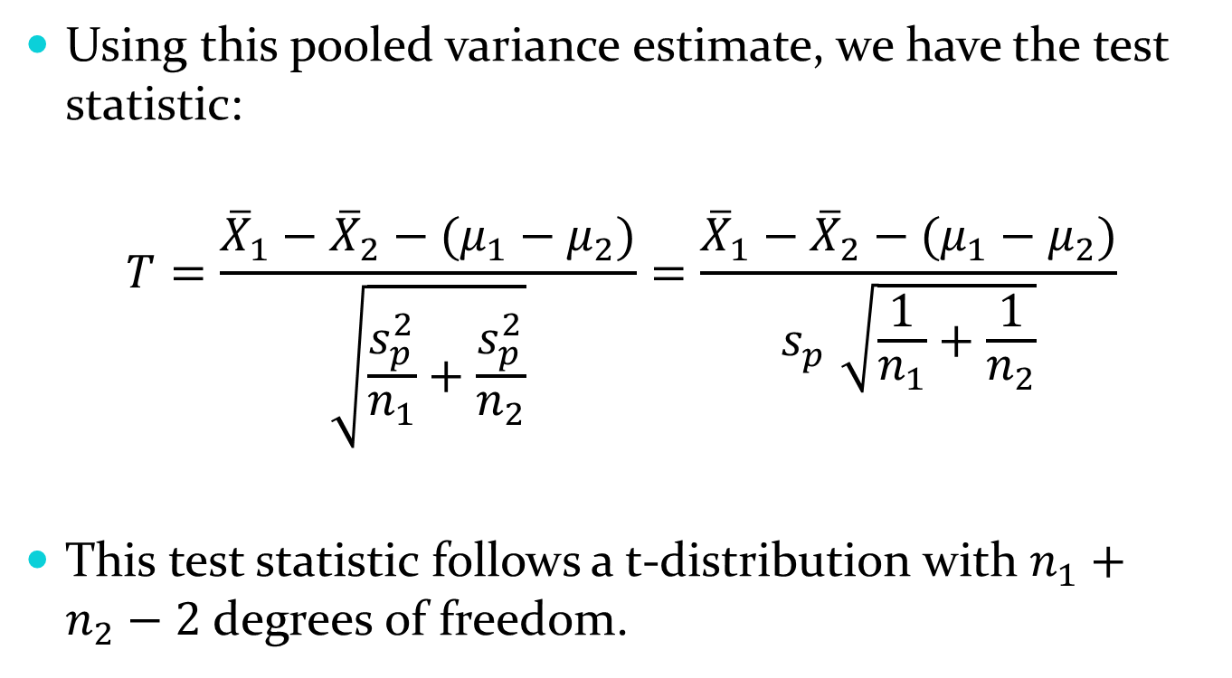
10.5 – Test for Two Means
Using this pooled variance estimate, we have the test statistic:
$$T=\frac{{\overline{X}}_{1}−{\overline{X}}_{2}−(μ_{1}−μ_{2})}{\sqrt{\frac{s_{p}^{2}}{n_{1}}+\frac{s_{p}^{2}}{n_{2}}}}=\frac{{\overline{X}}_{1}−{\overline{X}}_{2}−(μ_{1}−μ_{2})}{s_{p}^{}\sqrt{\frac{1}{n_{1}}+\frac{1}{n_{2}}}}$$
This test statistic follows a t-distribution with $n_{1}+n_{2}−2$ degrees of freedom.

Slide 22

10.5 – Test for Two Means
So while the computation is a little more involved, the process is exactly the same. We can get critical values and p-values from the t-distribution with $n_{1}+n_{2}−2$ degrees of freedom to make decisions about the hypotheses.

Slide 23
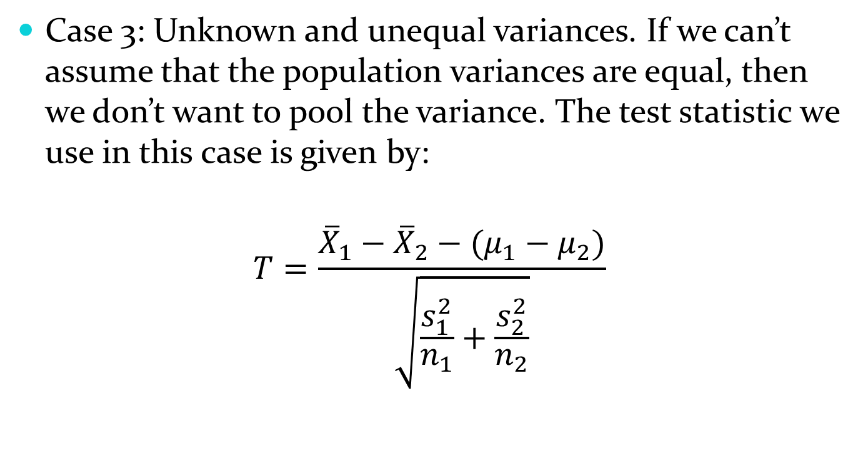
10.5 – Test for Two Means
Case 3: Unknown and unequal variances. If we can’t assume that the population variances are equal, then we don’t want to pool the variance. The test statistic we use in this case is given by:
$$T=\frac{{\overline{X}}_{1}−{\overline{X}}_{2}−(μ_{1}−μ_{2})}{\sqrt{\frac{s_{1}^{2}}{n_{1}}+\frac{s_{2}^{2}}{n_{2}}}}$$

Slide 24
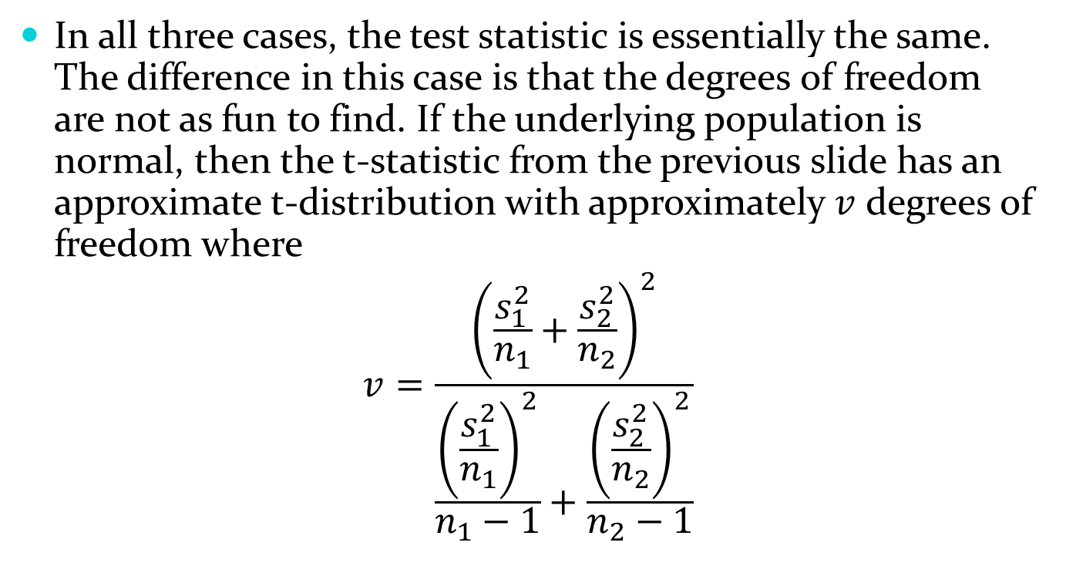
10.5 – Test for Two Means
In all three cases, the test statistic is essentially the same. The difference in this case is that the degrees of freedom are not as fun to find. If the underlying population is normal, then the t-statistic from the previous slide has an approximate t-distribution with approximately $v$ degrees of freedom where
$$v=\frac{{\left(\frac{s_{1}^{2}}{n_{1}}+\frac{s_{2}^{2}}{n_{2}}\right)}^{2}}{\frac{{\left(\frac{s_{1}^{2}}{n_{1}}\right)}^{2}}{n_{1}−1}+\frac{{\left(\frac{s_{2}^{2}}{n_{2}}\right)}^{2}}{n_{2}−1}}$$

Slide 25

10.5 – Test for Two Means
As $v$ is not likely to be an integer, we typically round down to the nearest integer.

Slide 26
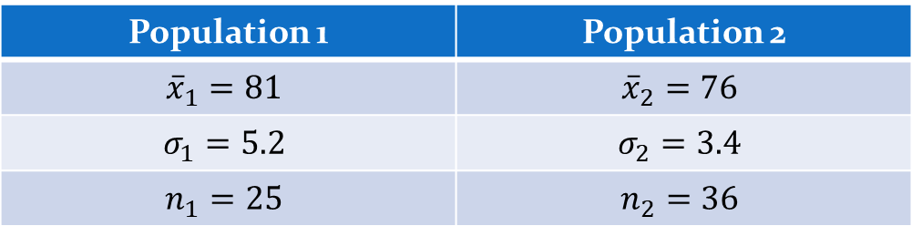
10.5 – Test for Two Means
Example: Given the following information, test the two-sided hypothesis that the two population means are equal at the 0.01 level of significance:
Population 1 | Population 2
$${\overline{x}}_{1}=81$$ | $${\overline{x}}_{2}=76$$
$$σ_{1}=5.2$$ | $$σ_{2}=3.4$$
$$n_{1}=25$$ | $$n_{2}=36$$

Slide 27
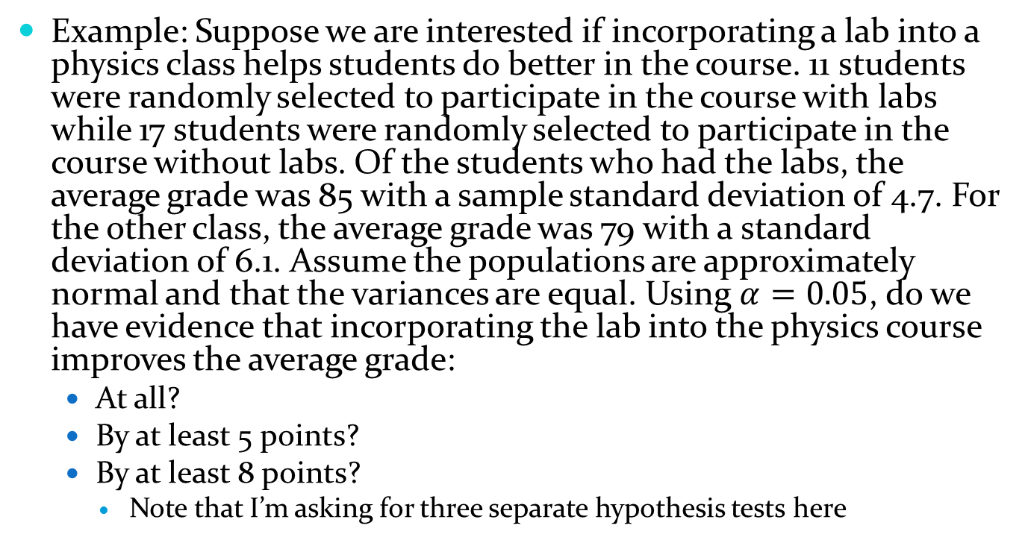
10.5 – Test for Two Means
Example: Suppose we are interested if incorporating a lab into a physics class helps students do better in the course. 11 students were randomly selected to participate in the course with labs while 17 students were randomly selected to participate in the course without labs. Of the students who had the labs, the average grade was 85 with a sample standard deviation of 4.7. For the other class, the average grade was 79 with a standard deviation of 6.1. Assume the populations are approximately normal and that the variances are equal. Using $α=0.05$, do we have evidence that incorporating the lab into the physics course improves the average grade:
  At all?
  By at least 5 points?
  By at least 8 points?
    Note that I’m asking for three separate hypothesis tests here

Slide 28
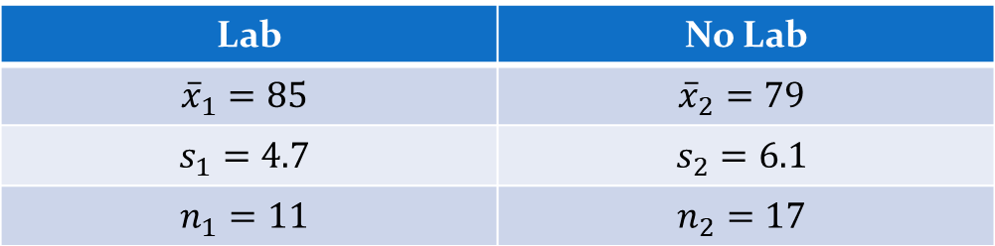
10.5 – Test for Two Means
It may be helpful to begin by organizing the given information into a table (though you don’t have to).
Lab | No Lab
$${\overline{x}}_{1}=85$$ | $${\overline{x}}_{2}=79$$
$$s_{1}=4.7$$ | $$s_{2}=6.1$$
$$n_{1}=11$$ | $$n_{2}=17$$

Slide 29
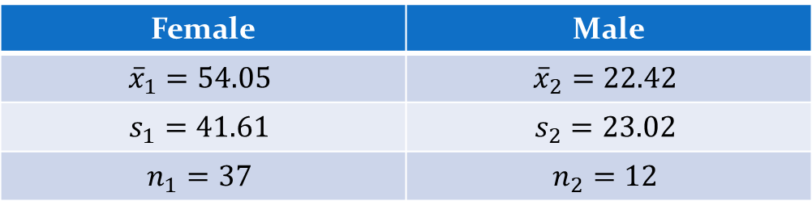
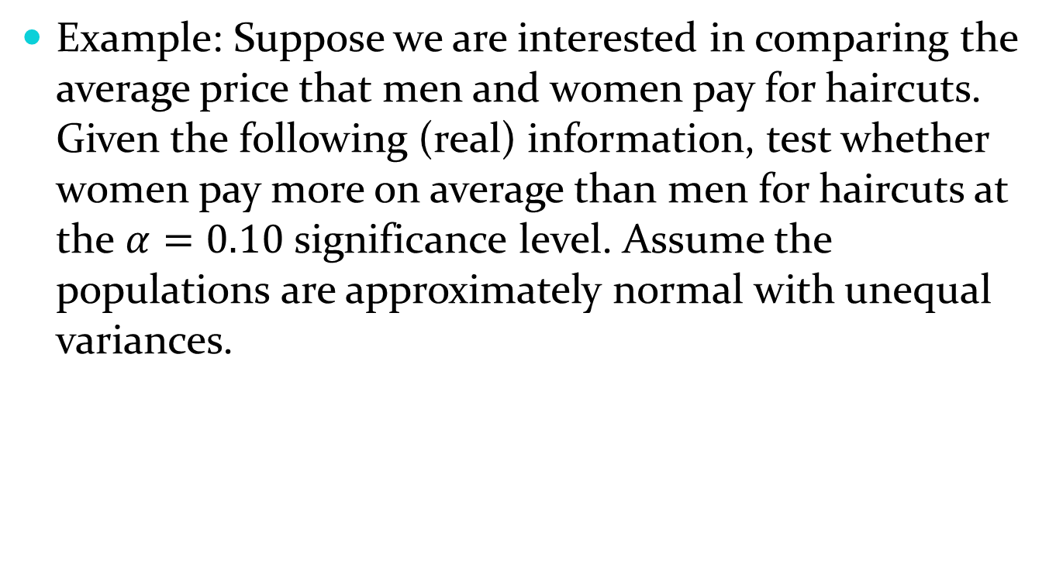
10.5 – Test for Two Means
Example: Suppose we are interested in comparing the average price that men and women pay for haircuts. Given the following (real) information, test whether women pay more on average than men for haircuts at the $α=0.10$ significance level. Assume the populations are approximately normal with unequal variances.
Female | Male
$${\overline{x}}_{1}=54.05$$ | $${\overline{x}}_{2}=22.42$$
$$s_{1}=41.61$$ | $$s_{2}=23.02$$
$$n_{1}=37$$ | $$n_{2}=12$$

